Slide 1

Year 6 Parent Meeting - SATs week information
Wednesday 28th January 2026

Slide 2
Reminder - The Year 6 team
Mrs J Price – KS2 Assistant Headteacher
Teachers Miss Tate Mrs Ransom Mrs Colclough Miss Showell
HLTA/TAs
Ms Hussain Mr Taqawi Mr Haley Mrs Hynes

Slide 3
WHAT ARE SATS AND WHY DO CHILDREN TAKE THEM?
S – Statutory
A - Assessment
T - Tests
End of Key Stage measure of attainment and
pupil progress.
They are a culmination of all learning undertaken throughout Key Stage 2, from age 7 to 11 years

Slide 4
What are children tested on?
English
- Grammar, Punctuation and Spelling (GPS) 45 min paper
Spelling – 20 words 15 min
Reading Comprehension - 1 hour
Writing – Teacher Assessed against national standards
Mathematics
Arithmetic - 30 mins
Mathematical Reasoning (2 papers) - 40 mins each
Science
- Teacher assessed against national standards

Slide 5
SATs week 2026
Monday 11th May 2026 – Thursday 14th May
MONDAY – GPS PAPER 1 AND PAPER 2
TUESDAY - READING
WEDNESDAY – MATHEMATICS PAPER 1 AND PAPER 2
THURSDAY – PAPER 3
FRIDAY - 🍕🎉

Slide 6
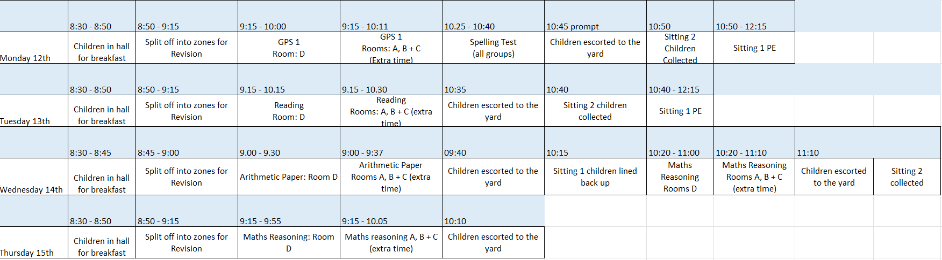
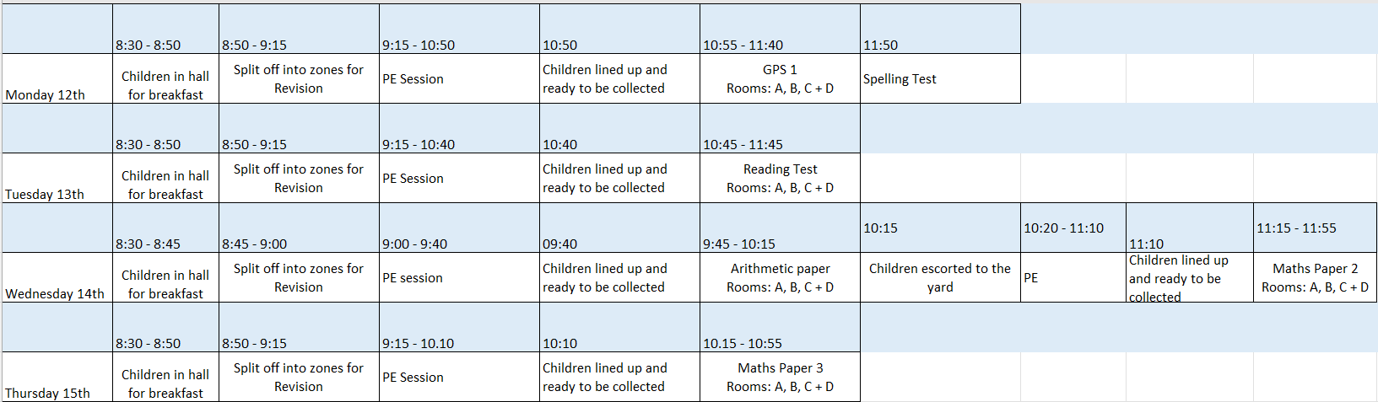
SATs week – there will be 2 sittings
Monday 11th May 2025 – Thursday 14th May
8:30am start
Time with peers – eating/chatting together
Individual check ins with pupils
All Y6 team present
Sitting 1
It is recommended that pupils have down time before or after a paper that includes something physical (ideally outdoors) so the children can work off energy, be loud and let off steam.
This is an example from last year so Monday says 12th rather than 11^{th.}
SATs week will run in the same way this year and a timetable will be written nearer the time, and we will share with pupils the week prior what sitting they are in and which adult/s are working with them.
Sitting 2

Slide 7
SATs week- Monday 11th May 2025 – Thursday 14th May
Key details
Y6 pupils to arrive at 8:30am and come into the hall
Breakfast snacks (cereal bars, toast) will be provided
Pupils will split into classes at 8.50am for register & a short revision session
Two sittings (sitting 1/sitting 2 – rooms A,B,C,D) Sitting 1 begin test at 9:15am (9am on Wednesday)
Pupils engage in sports activities when the other group are sitting tests – there will be NO contact between groups until all pupils have sat the test
Pupils will sit tests in Y6 classrooms with familiar adults Additional adults (SLT, teachers, TAs) will be used as prompters, scribes, readers for pupils who qualify

Slide 8
Intervention
We are currently running morning maths and reading booster groups (8.15am) and lunch time reading and arithmetic booster groups.
If your child has been invited to one of these groups, it is very important that they attend.
Each group is specifically designed to plug gaps in their knowledge, as identified from most recent tests completed.

Slide 9
What can you do to support your child?
Encourage them to read including on Reading Plus 5+ times a week.
Support them with using Times Tables Rockstars to improve their times table knowledge/speed.
Encourage them to use apps/games that target areas they know they need to work on (e.g. spelling Y5/6 words, finding percentages).
Making sure they complete their homework.

Slide 10
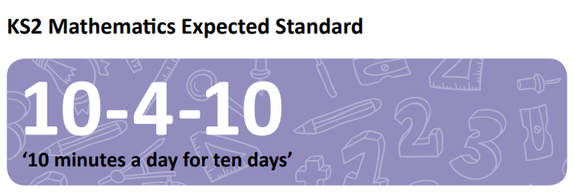
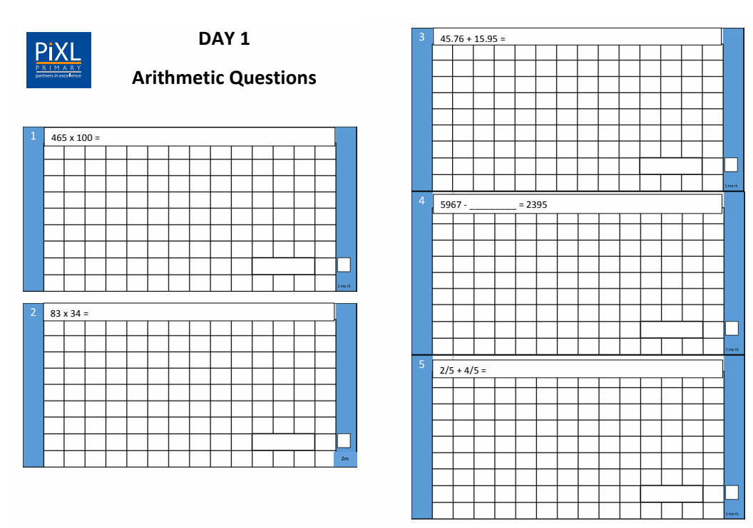
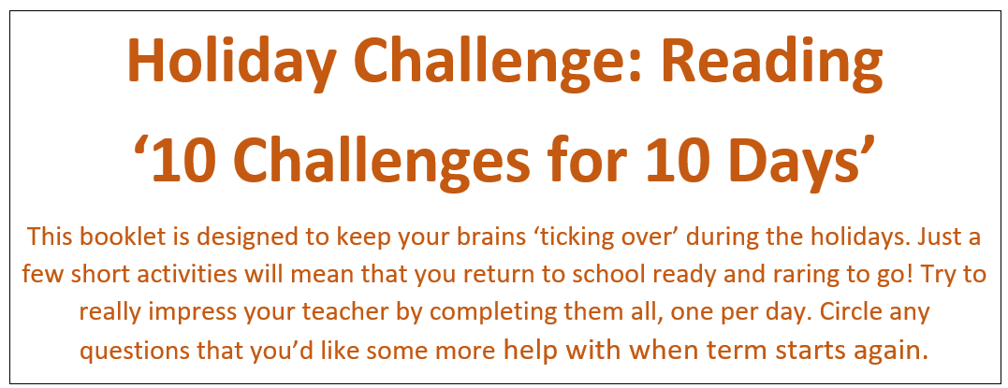
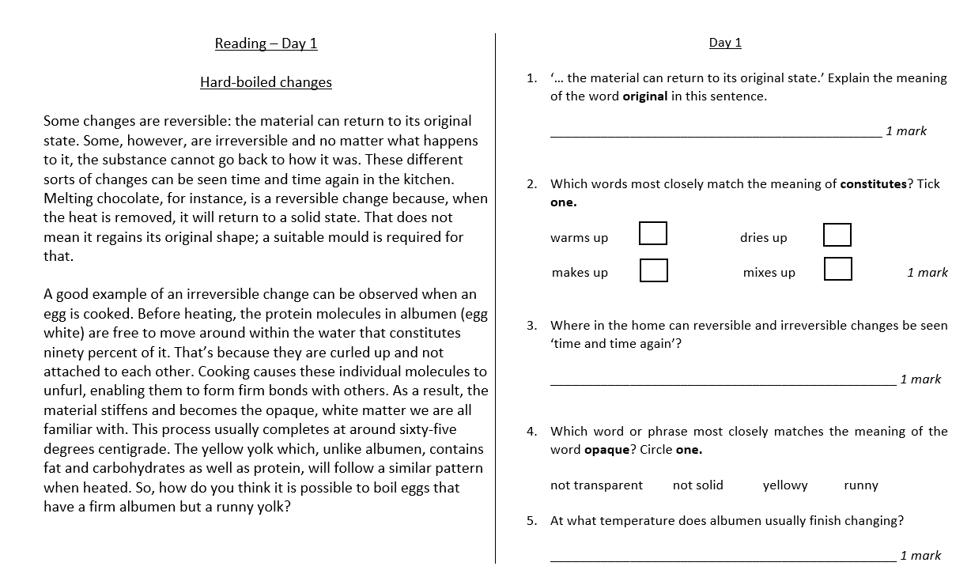
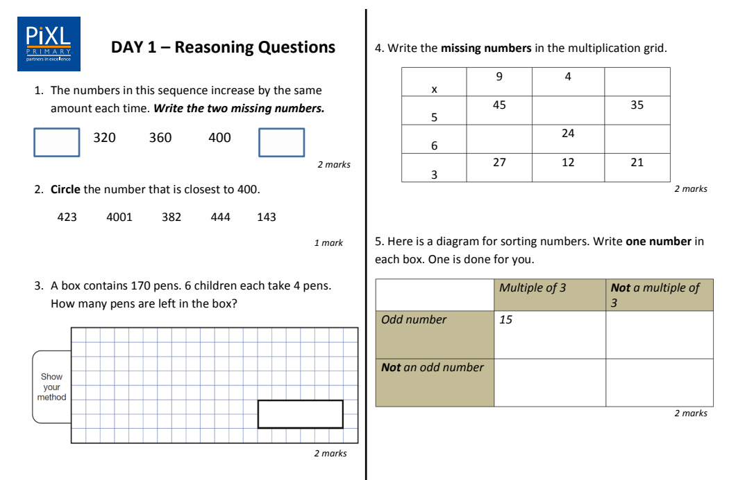
Easter challenge booklets These will be given to the children before they break up for Easter.

Slide 11
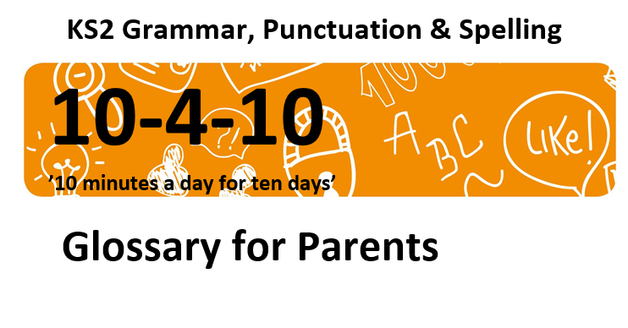
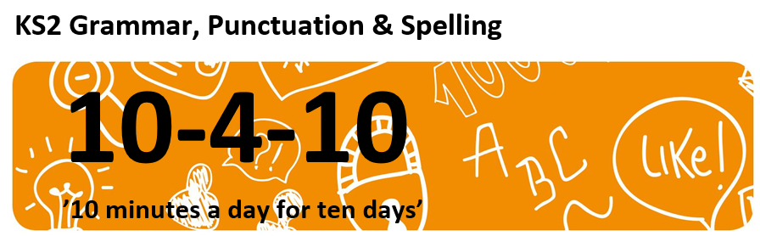
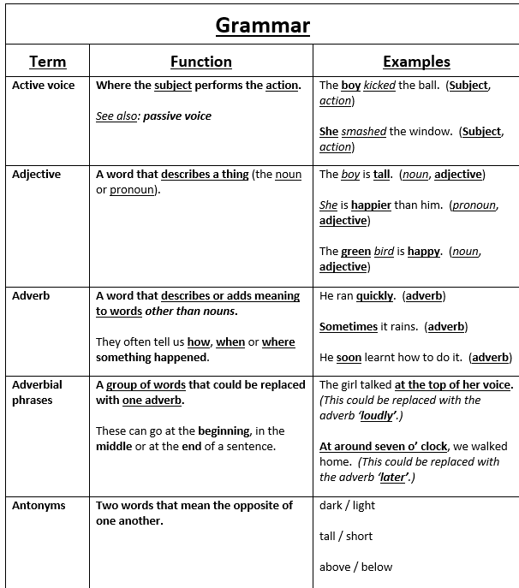
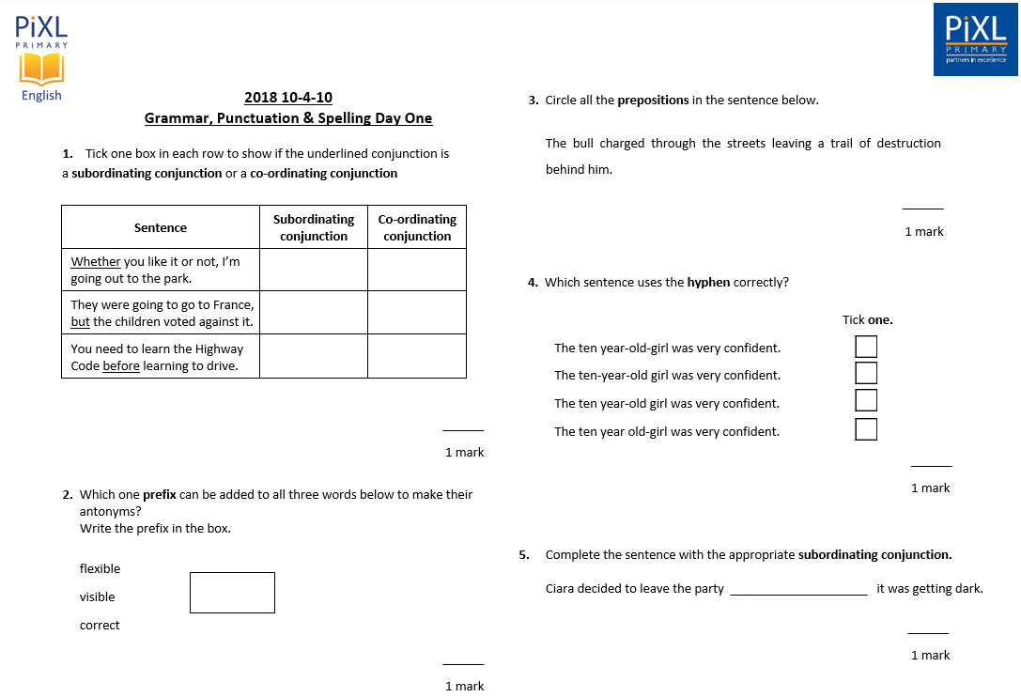
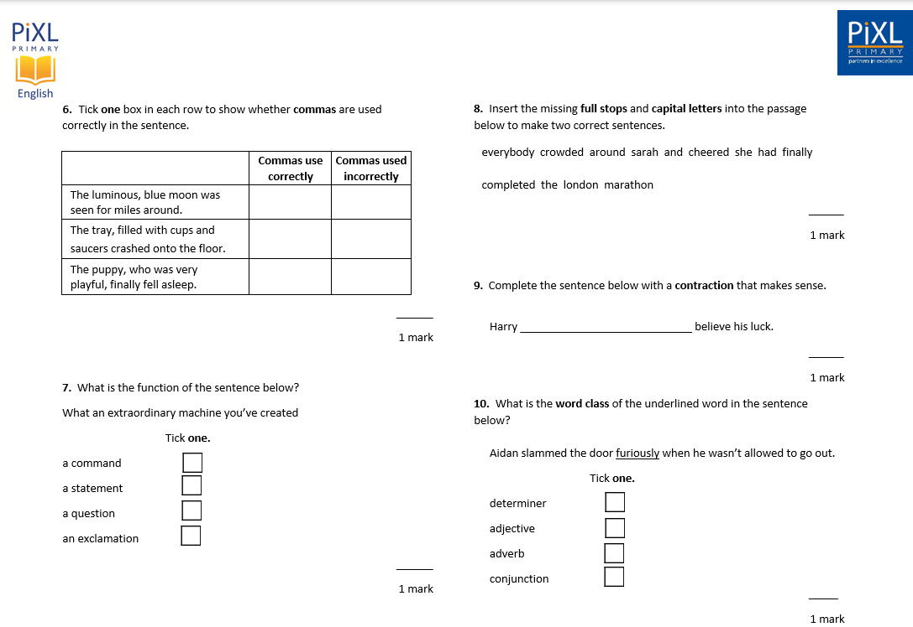
Easter challenge booklets These will be given to the children before they break up for Easter.

Slide 12
English GRAMMAR, PUNCTUATION AND SPELLING

Slide 13
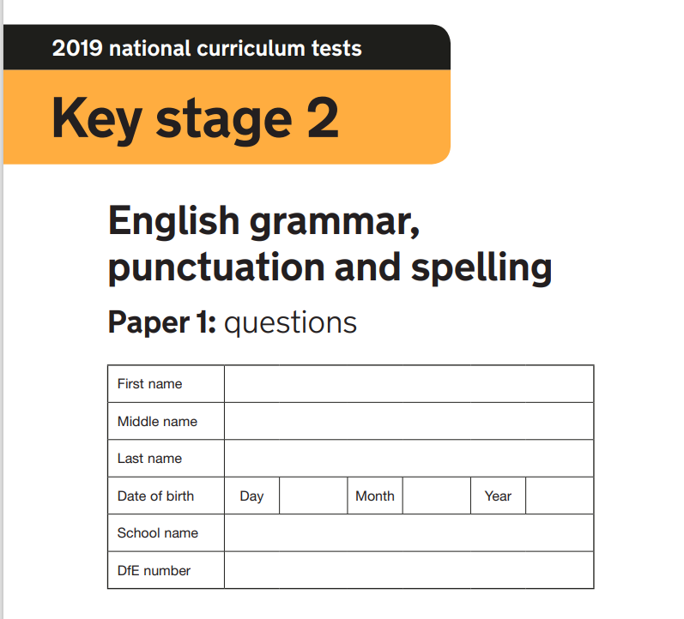
Paper 1
Exclamation mark inside inverted commas
Adding a prefix
Possessive apostrophe
Subject/verb agreement (was/were)
Purpose of commas (separating clauses)
Function of sentences
Identify adverbs in a sentence
Identify verbs in a sentence
Awareness of sentence breaks
Correct use of inverted commas in a sentence
Correct use of capital letters in a sentence
Correct use of Standard English (weren't)
Identify prepositions in a sentence
Punctuation errors in a sentence
Function of 'back' in a sentence (adverb/adjective/noun)
Insert full stop and question mark into a passage
Contraction to complete a sentence
Identify a noun phrase
Change a question into a command
Correct use of commas to mark a fronted adverbial
Correct determiner to complete sentences (a/an/the)
Use possessive pronouns
Match words to synonyms
Modal verbs for certainty
Correct use of hyphens
Identify pronouns
Identify past tense verbs
Form an adjective from a verb
Identify subordinate clauses in sentences
Correct use of dash
Present progressive tense
Adding a suffix
Use a relative clause
Active or passive voice
Identify adjectives
Demonstrate direct speech
Correct use of a semi-colon
Past perfect or present perfect tense
Subjunctive form
Meaning of root word
Identify adverbial phrase
Identify subject/object in a sentence
Form a sentence
Adding a suffix to make a noun
Identify conjunctions
Use simple past tense
Identify subordinating and co-ordinating conjunction
Correct use of brackets
How the hyphen changes meaning
Identify nouns
2019 key stage 2 English grammar, punctuation and spelling Paper 1: questions (publishing.service.gov.uk)

Slide 14
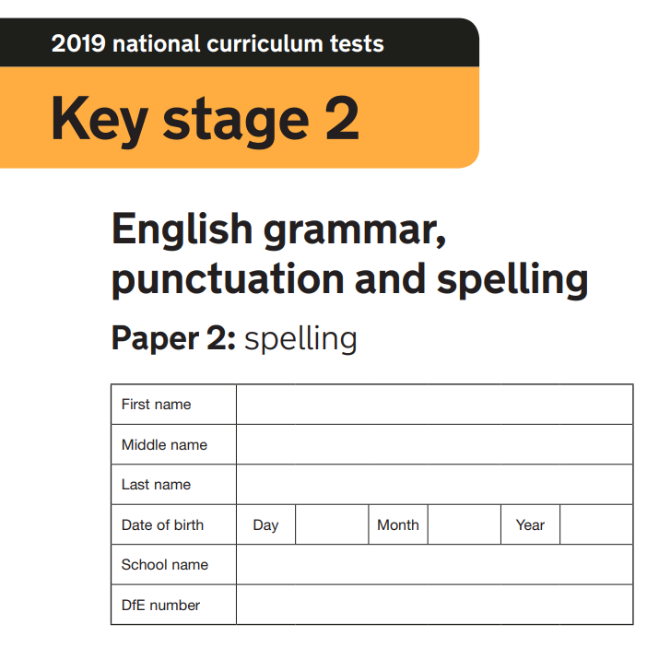
Paper 2
Example of the 20 spellings
grey
strength
gathering
variable
knight
confident
cough
suffering
imagination
symbol
measure
dismayed
precious
seriously
courage
artificial
determined
unscented
choir
receipt
2019 key stage 2 English grammar, punctuation and spelling Paper 2: spelling (publishing.service.gov.uk)

Slide 15
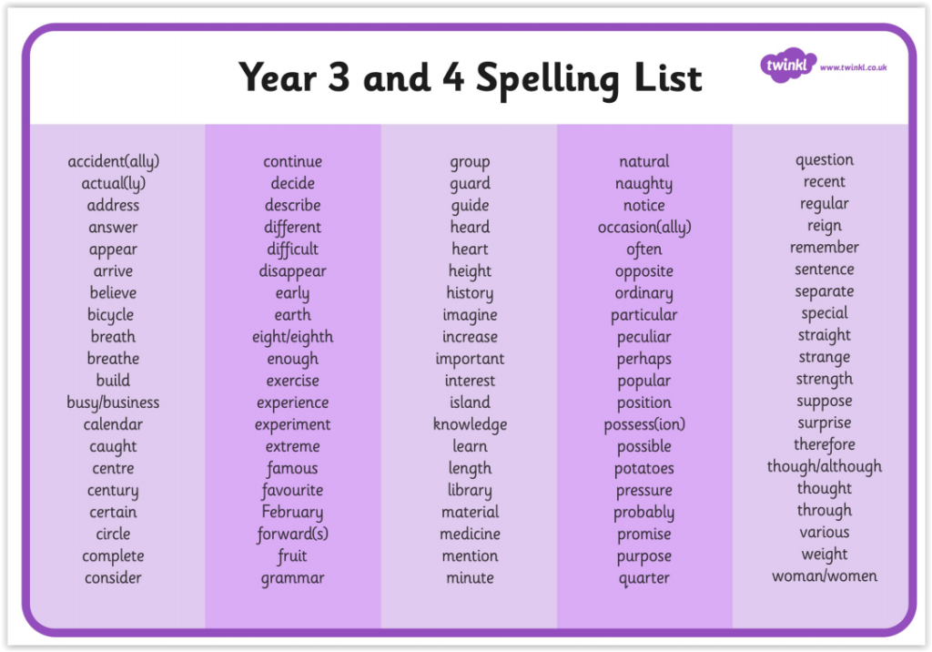
Year 3 and 4 Spellings for Writing

Slide 16
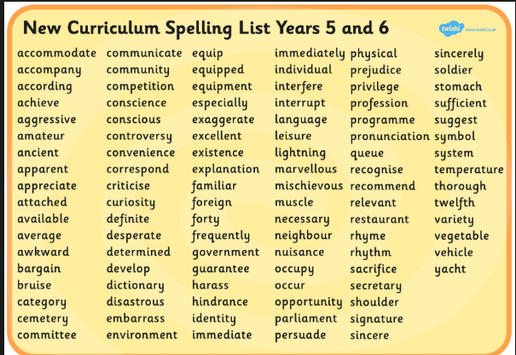

Year 5 and 6 Spellings for Writing
EdShed

Slide 17

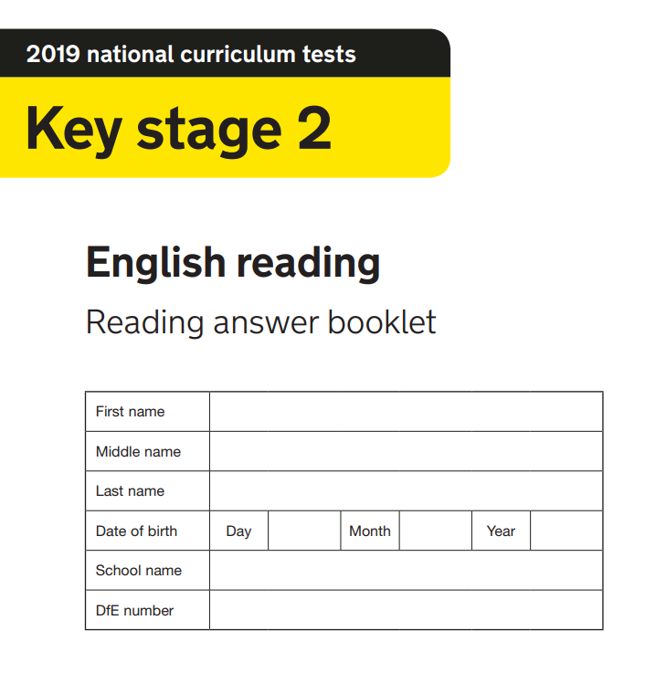

Reading stamina and resilience
2019 key stage 2 English reading booklet (publishing.service.gov.uk)
2019 key stage 2 English reading Reading answer booklet (publishing.service.gov.uk)
Reading Speed:
A minimum of 90 words per minute.

Slide 18
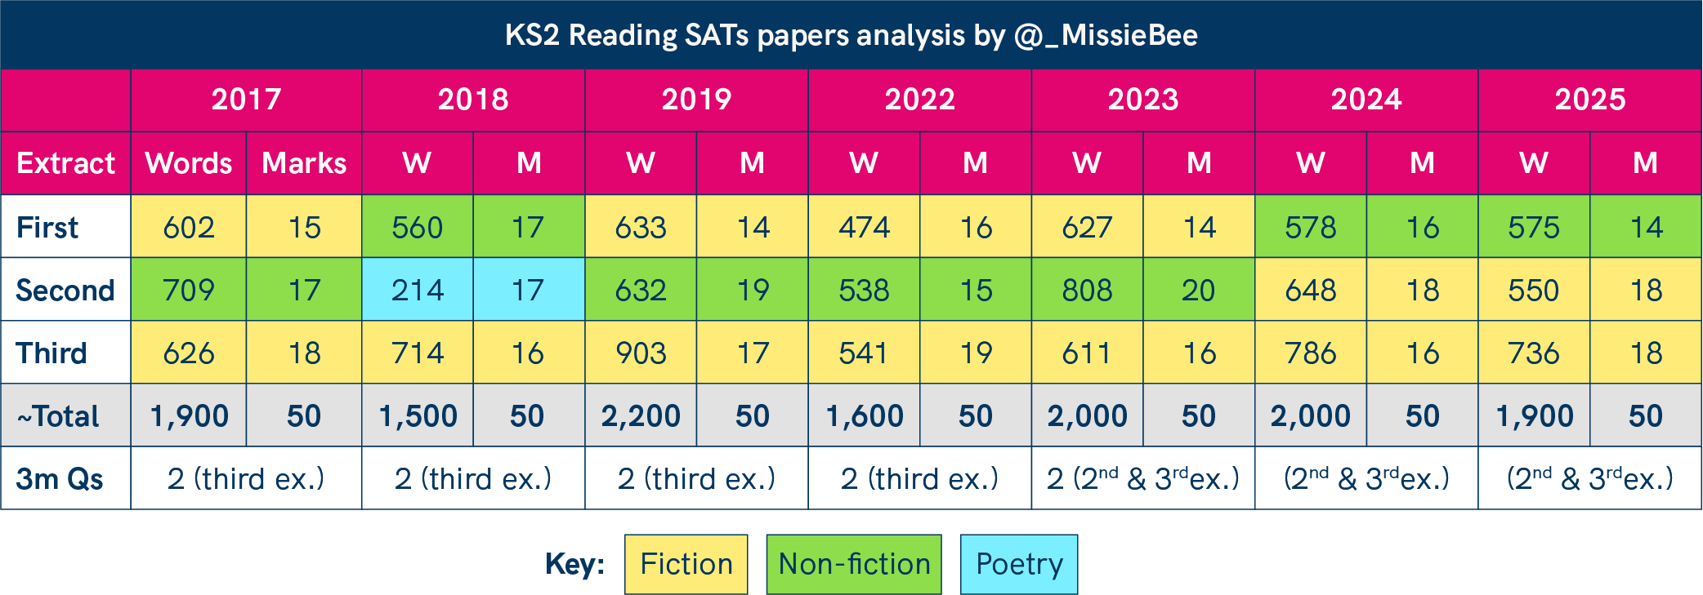

Slide 19




READING
All pupils have a login
They should read on Reading Plus DAILY

Slide 20
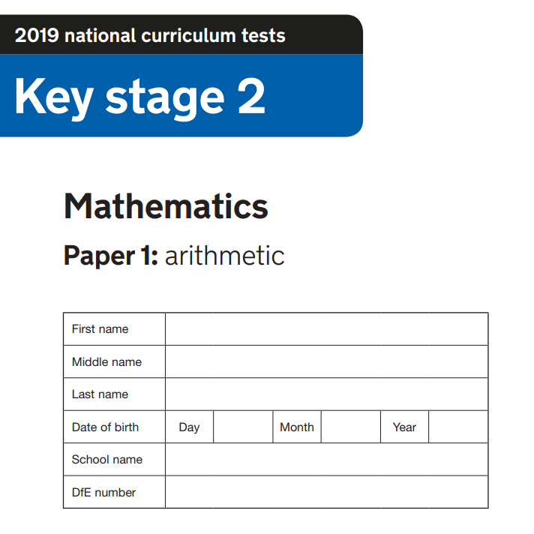

Paper 1 - Arithmetic
Negative numbers
Number
bonds
Four
operations
FDP

Slide 21
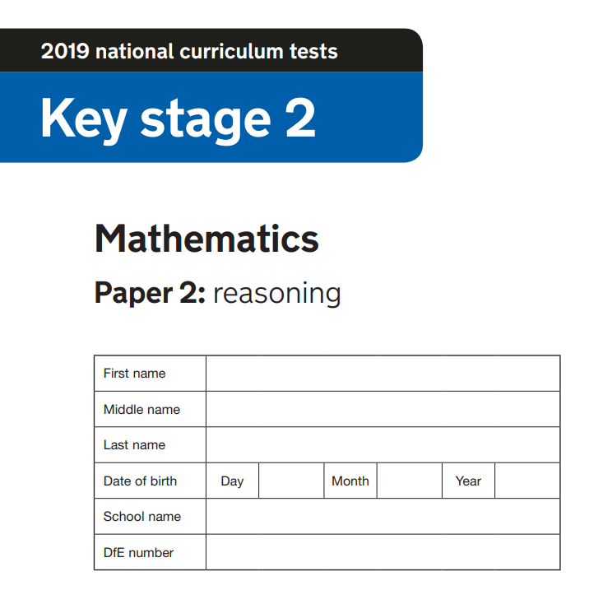
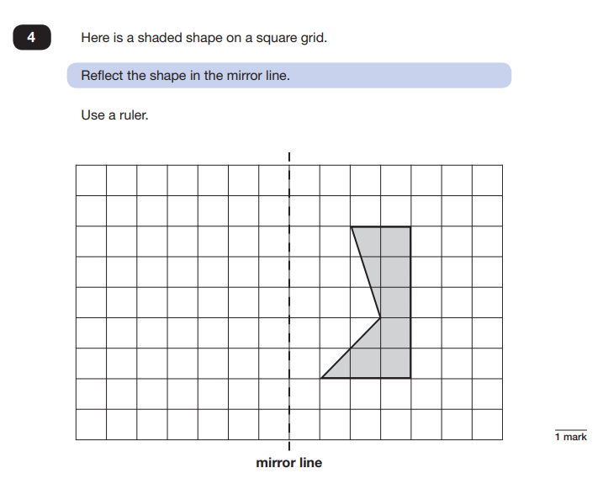
Paper 2 - Reasoning
2019 key stage 2 mathematics Paper 2: reasoning (publishing.service.gov.uk)

Slide 22
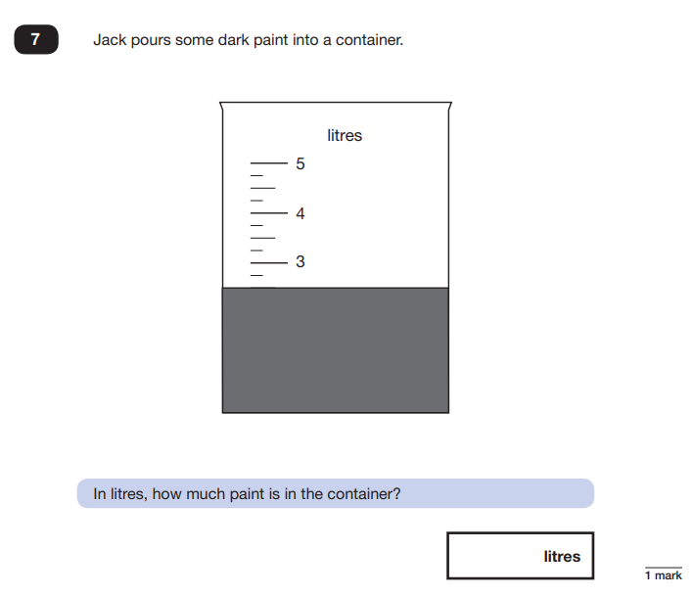
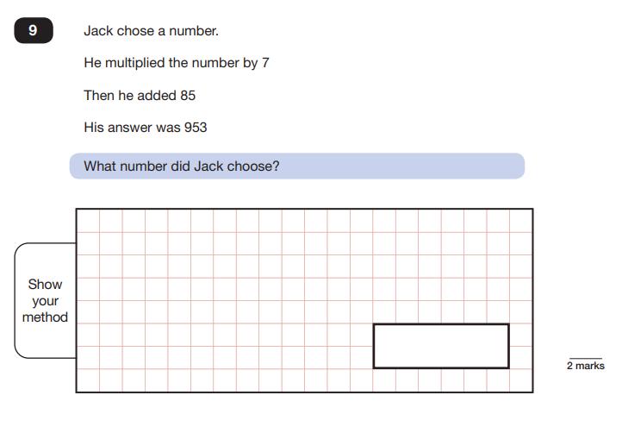
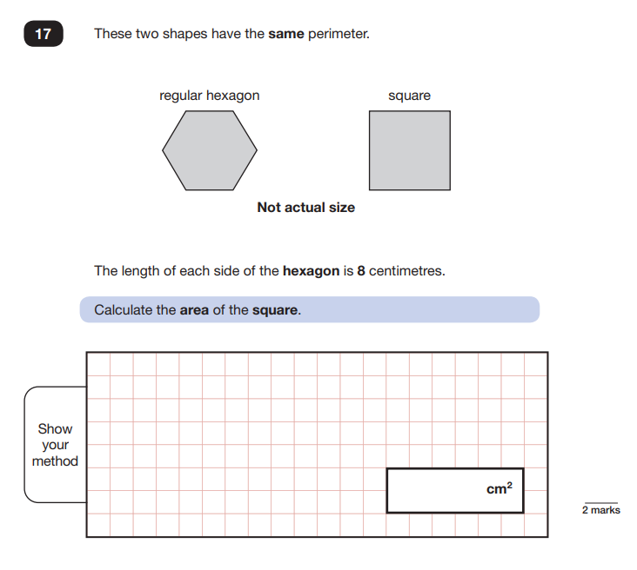

Slide 23
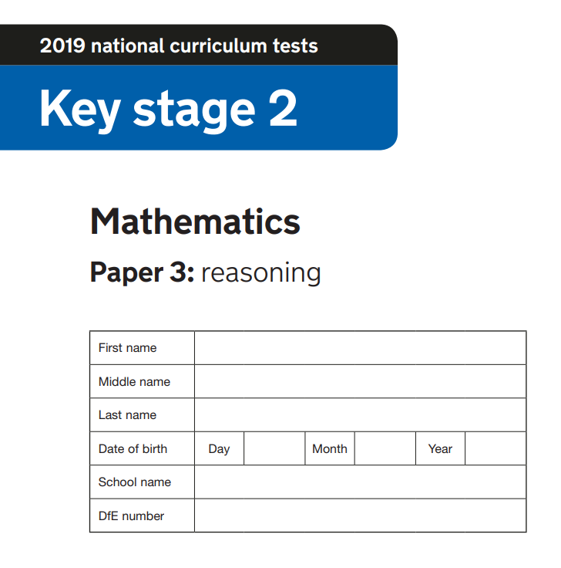
Paper 3 - Reasoning

Slide 24
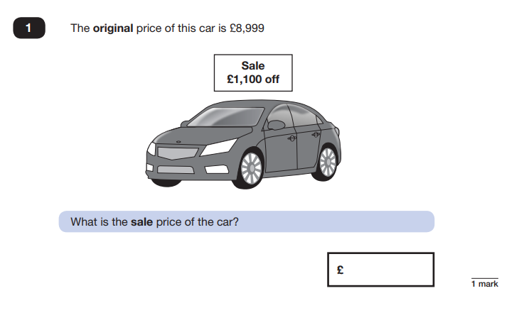
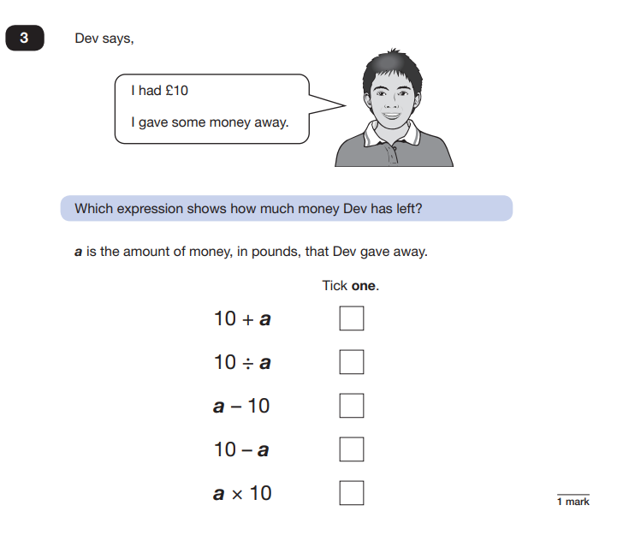
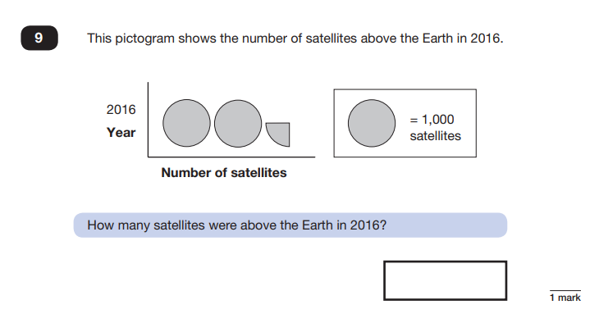
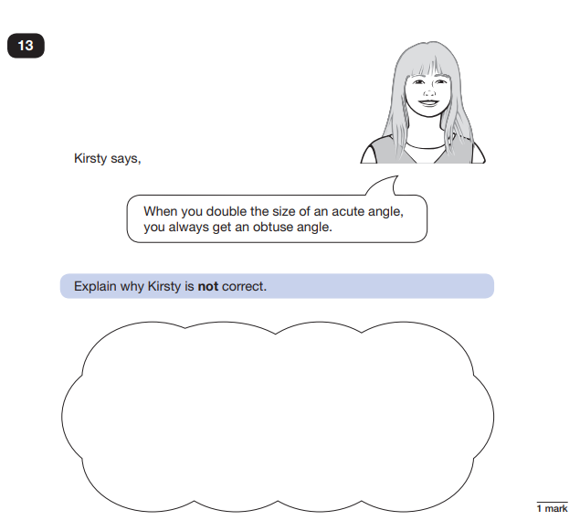

Slide 25

Mathematics
There are many free websites that pupils can use for maths revision, including:
IXL - Year 6 maths practice
Year 6 Maths - BBC Bitesize
Maths Genie - Primary - KS2 SATs Revision
Third Space Learning – make a free account to access primary maths resources

Slide 26
APPs available to help your child
Searching ‘KS2 reading comprehension’, ‘KS2 GPS’, ‘KS2 Spelling’, ‘KS2 Maths’ will bring up a range of free APPs as well as APPs you can purchase.
If you are looking to purchase APPs, the following have been recommended:
Achieve 100 – Year 6 Mathematics
Achieve 100 – Y6 GPS
Pearsons – Talk Maths Year 6 (there are other year groups available too)
Games
Chess, Sudoku, 1010, Othello, Fourinarow, Tetrus, Word Jigsaw, Scrabble
These games, plus many others, develop strategy and reasoning or enable children to work on spellings etc.

Slide 27


Physical Resources available to your child:
Playing cards and dominos
Board games
Reading books – school, local library, magazines/newspapers
Maths games (such as battleships)
Jigsaws
Shopping trips
Cooking
Most importantly – YOU!

Slide 28
How can I help my child stay on track?
Attendance - ensure your child is in school as much as possible:
100% attendance - 0 days of learning missed
95% attendance - equivalent to 9 days of learning missed over the course of a year
90% attendance - equivalent of 19 days of learning missed over course of a year
85% attendance - equivalent of 28 days of learning missed over the course of a year
80% attendance & below - equivalent of at least 38 days of learning missed
Punctuality is important – school starts at 08:45
Your child MUST be in school on time every day during SATs week – 8:30am. They must not be absent.
Speak to Mrs Price ASAP if you foresee any issues

Slide 29
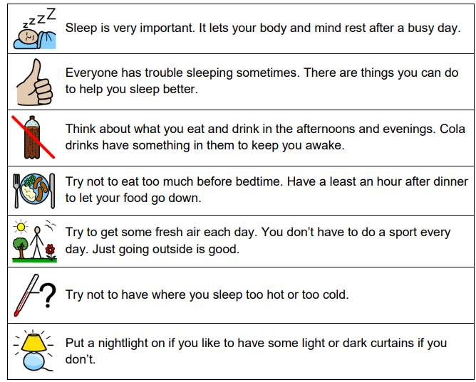
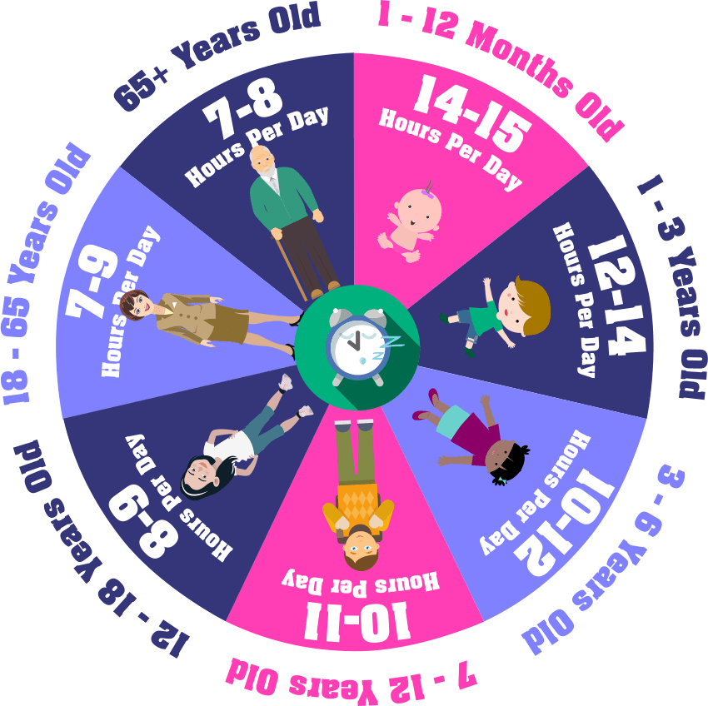
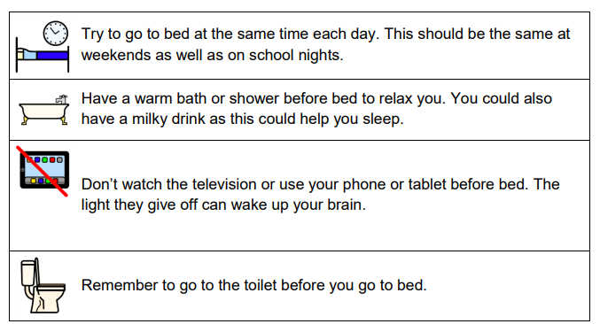
Is your child getting enough sleep?
Pupils MUST get a good night’s sleep to be at their best
Getting_a_good_nights_sleep.pdf

Slide 30





Behaviour
You have our support & we need yours

Slide 31

Whilst we do encourage your children to take these tests seriously and use them to show off all that they are capable of, it is important to remember that all the children in Year 6 are special and unique irrespective of a test.
The value and worth of each child cannot be quantified by a test level and nor should it.
If you have any concerns before or during SATs week, speak to Mrs Price (KS2 AHT) or any of the Y6 team.

Slide 32

Thank you for taking the time to come along this afternoon. Any questions?

